Slide 1
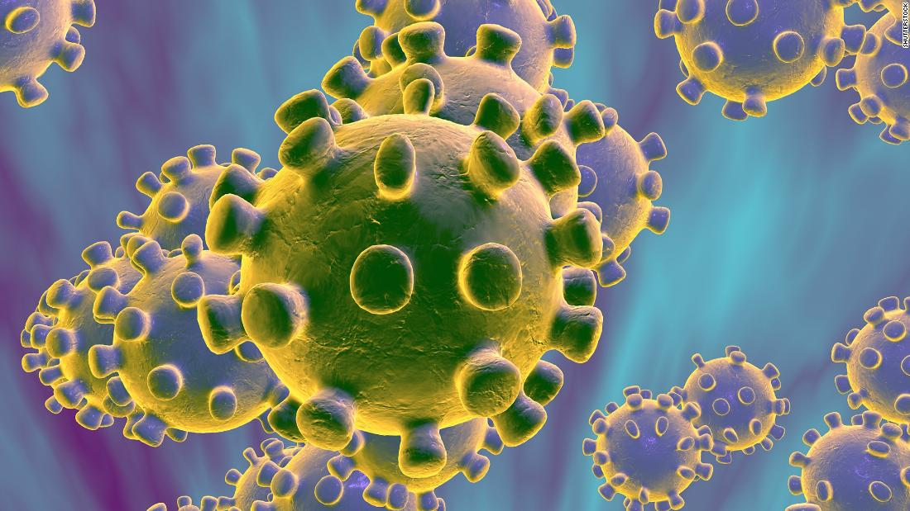
COVID-19 Infection Prevention and Control For Care Home Settings
May 2020 Version 1a

Slide 2
Introduction & background
Principle 1: Standard Infection Prevention Precautions
Principle 2: Personal Protective Equipment
Principle 3: Isolation / Patient Placement
Principle 4: Cleaning and Disinfection

Slide 3
Background & introduction

Slide 4
Coronavirus and COVID-19
Coronaviruses are a large family of viruses - most causing mild common cold like symptoms
Since 2003 a series of novel corona viruses causing more severe disease have been identified - Severe Acute Respiratory Syndrome (SARS) in 2003 and Middle East Respiratory Syndrome (MERS) in 2012
The virus SARS-CoV-2 is not new to the world but is new to humans. It has crossed from animals into humans and is now spreading human to human
The virus causes symptoms and the disease is known as COVID-19
Notes:
Coronaviruses didn’t just pop up recently. They’re a large family of viruses that have been around for a long time. Many of them can make people ill with sniffles or coughing. Before the SARS-CoV-2 outbreak, coronaviruses were thought to cause only mild respiratory infections in people.
The new (or “novel”) coronavirus is one of several known to infect humans. It’s probably been around for some time in animals. Sometimes, a virus in animals crosses over into people. That’s what scientists think happened here. So this virus isn’t new to the world, but it is new to humans. When scientists found out that it was making people sick in 2019, they named it as a novel coronavirus.
Human Coronavirus Types
Scientists have divided coronaviruses into four sub-groupings, called alpha, beta, gamma, and delta. Seven of these viruses can infect people. The four common ones are:
229E (alpha)
NL63 (alpha)
OC43 (beta)
HKU1 (beta)
The three less-common ones are:
MERS-CoV, a beta virus that causes Middle East respiratory syndrome (MERS)
SARS-CoV, a beta virus that causes severe acute respiratory syndrome (SARS)
SARS-CoV-2, which causes COVID-19

Slide 5
SARS-CoV-2
Humans had no immunity to help block transmission
There is still a lot that we are discovering
Incubation period (average 5 days, range 1-14 )
Pre- and asymptomatic carriers on transmission of infection
How long immunity lasts (how long antibodies remain in the blood and provide protection )
How likely reinfection is
There is no specific treatment
There is no vaccination even for high-risk groups
Notes:
Infection in asymptomatic individuals: Asymptomatic infection at time of laboratory confirmation has been reported from many settings; a large proportion of these cases developed some symptoms at a later stage of infection. There are, however, also reports of cases remaining asymptomatic throughout the whole duration of laboratory and clinical monitoring. Persistent positivity of viral RNA in throat for more than 2 weeks has been reported.
Transmission in pre-symptomatic stage of infection: No significant difference in viral load in asymptomatic and symptomatic patients has been reported, indicating the potential of virus transmission from asymptomatic patients . Major uncertainties remain with regard to the influence of pre-symptomatic transmission on the overall transmission dynamics of the pandemic because the evidence on transmission from asymptomatic cases from case reports is suboptimal. Pre-symptomatic transmission has also been inferred through modelling.
Pre-symptomatic transmission was deemed likely based on a shorter serial interval of COVID-19 (4.0 to 4.6 days) than the mean incubation period (five days). The authors of this study indicated that many secondary transmissions would have already occurred at the time when symptomatic cases are detected and isolated.

Slide 6
Severity of COVID-19 illness
Most people have no obvious symptoms (30-40%)
Most children get mild disease
More severe disease related to:
Age (over 65 in particular)
Diabetes
Heart disease
Chronic respiratory disease
Compromised / suppressed immunity
Less than 2% of cases fatal
Highest in high risk groups
Cancer
Obesity
Notes:
* Very early reports of a new syndrome in low numbers of children in UK which MAY be as a result of COVID-19

Slide 7
What are the symptoms of COVID-19?
Symptom | Proportion of cases
Fever >37º5 Chills / shaking | 48.7%
Dry or productive cough | 24%
Sore throat | 11.8%
General weakness | 8.4%
Pain | 6.9%
Runny nose | 3.6%
Diarrhoea | 1.7%
Incubation period 5-6 days after exposure (range is 1-14 days)
Commonly have fever and dry cough (rapid onset) but not everyone
Symptoms last av 5 - 6 days
Severe illness starts day 7
↑ Shortness of breath
Decrease in O₂
Lung inflammation
Pneumonia
https://www.nhs.uk/conditions/coronavirus-covid-19/check-if-you-have-coronavirus-symptoms/
Other lesser reported symptoms: headache, loss of taste / smell, and delirium in the elderly
Notes:
https://www.ecdc.europa.eu/sites/default/files/documents/covid-19-rapid-risk-assessment-coronavirus-disease-2019-ninth-update-23-april-2020.pdf
The most commonly reported clinical symptom was fever/chills (48.7%), dry or productive cough (24%), sore throat (11.8%), general weakness (8.4%), pain (6.9%), runny nose (3.6%) and diarrhoea (1.7%). These figures may not be representative for all COVID-19 cases, given the variation between countries in the frequency of symptoms reported, possibly reflecting differences in testing policies or recording clinical history. Among countries with information on symptoms available for more than 100 cases, the most common symptoms remained cough (22– 83%, six countries) and fever (25–70%, five countries). Pooled and country-specific TESSy data will soon be available in an online weekly report, published on the ECDC website.
In interviews of 48 healthcare staff in King County, USA, the most common initial symptoms were cough (50.0%), fever (41.7%), and myalgias (35.4%) [5]. US CDC also lists chills, repeated shaking without chills, headache and a loss of taste or smell as possible symptoms of COVID-19 [6]. In addition, conjunctivitis has been reported as a symptom [7].

Slide 8
How is COVID-19 transmitted?
Exposure to respiratory droplets
Coughing/sneezing small droplets which are then inhaled
Contact with respiratory secretions
Directly or via contaminated surfaces
Tissues contaminated with respiratory secretions
Transferred by touching mucous membranes
Not transmitted in air except during a procedure involving the respiratory tract that generates aerosols
Close contact required for this to occur (within 2m)
Notes:
SARS-CoV-2 virus has been detected in respiratory secretions (upper and lower respiratory tract) and faeces. The main route of transmission is considered to be through inhalation of large
respiratory droplets or deposition on mucosae. Viral RNA has been detected in blood but there is no evidence that SARS-CoV-2 can be transmitted through contact with blood
Contact with contaminated fomites due to persistence of the virus on surfaces is another route implicated in the transmission of SARS-CoV-2 virus. Faecal-oral and airborne modes have also been considered, but their role in the transmission of SARS-CoV-2 is currently unknown. In order to reduce the risk of infection through fomites, it is essential to establish procedures for the correct disinfection of environments that could have been contaminated with SARS-CoV-2.
Recent publications have evaluated the survival of SARS-CoV-2 on different surfaces. The environmental stability of SARS-CoV-2 is up to three hours in the air post-aerosolization (dependent on air changes/hour), up to four hours on copper, up to 24 hours on cardboard and up to two to three days on plastic and stainless steel, albeit with significantly decreased titres. These findings are comparable with results obtained for environmental stability of SARS-CoV-1. These findings resulted from experiments in a controlled environment and should be interpreted with caution in the real-life environment

Slide 9
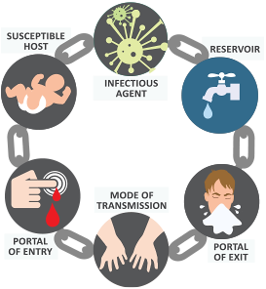
Chain Of Infection
Hand Hygiene
Standard Precautions
Cleaning
(Kundrapu et al., 2012, Guerrero et al., 2012, Stiefel et al., 2011).
Notes:
Cleaning

Slide 10
Useful resources
Public Health Wales
https://phw.nhs.wales/topics/latest-information-on-novel coronavirus-covid-19/
Gov.UK
https://www.gov.uk/government/publications/wuhan-novel-coronavirus-infection-prevention-and-control
UK Infection Prevention Society
https://www.ips.uk.net
Healthcare Infection Society COVID resources
https://www.his.org.uk/resources-guidelines/novel-coronavirus-resources/

