Slide 1
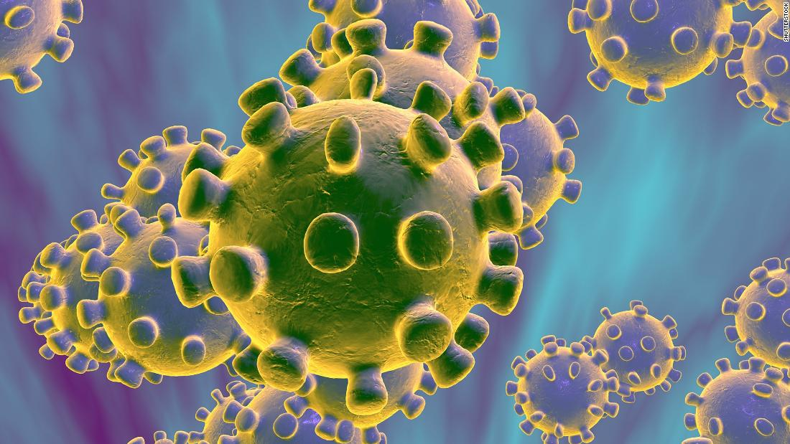


COVID-19
Infection Prevention and Control
For Care Home Settings
May 2020 Version 1a

Slide 2
Principle 1:
Standard Infection Prevention Precautions

Slide 3
Standard Precautions are a set of minimum infection prevention practices that apply in any healthcare setting
Standard Precautions include 4 of the key interventions to prevent the spread of COVID-19: https://phw.nhs.wales/services-and-teams/harp/infection-prevention-and-control/
Hand and respiratory hygiene
Use of personal protective equipment (e.g., gloves, masks, eyewear)
Isolation
Cleaning and disinfection of environmental surfaces

Slide 4
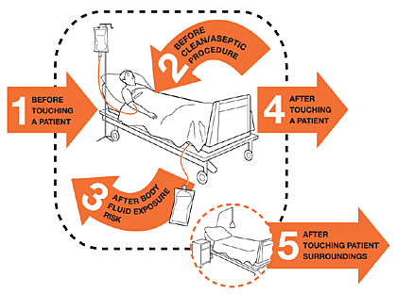
Standard Precautions
Hand Hygiene: when to clean your hands
Gloves are not a substitute for hand hygiene
Alcohol gel (at least 60%) is effective against COVID-19
Soap and water should be used if hands are soiled
Notes:
The WHO 5 moments still apply
Gloves are not a substitute for hand hygiene – they protect the wearer but if not changes between patients / residents or between different procedure with the same patient / resident then they become part of the problem
Don’t routinely gel or wash gloves
COVID-19 is an enveloped virus and therefore destroyed by alcohol hand rubs

Slide 5

How to wash your hands effectively
- in 20 seconds
Notes:
Play video

Slide 6
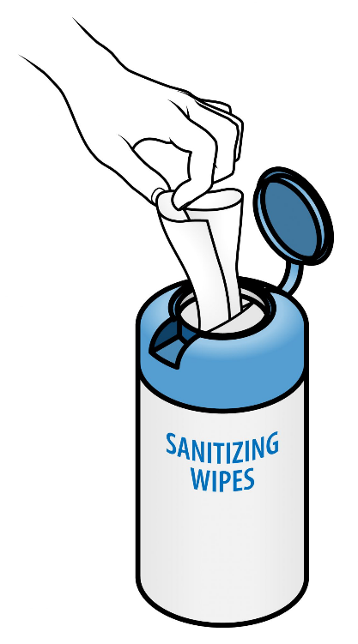
Patient/resident hand hygiene
Encourage patients/residents to clean their hands
  After coughing/sneezing
  Before and after eating
  After using the toilet / commode
Make hand wipes or alcohol hand rub available at bedside for residents to use (carry out a risk assessment)
Give them a bag for their waste tissues/wipes

Slide 7

Personal & respiratory hygiene to prevent spread
Cough or respiratory etiquette
  Cover mouth and nose with a tissue or your sleeve (not your hands)
  Dispose of tissues directly into bin
  Clean your hands
Ensure patients have hand wipes or alcohol hand rub available

Slide 8
Useful resources
Public Health Wales
https://phw.nhs.wales/topics/latest-information-on-novel coronavirus-covid-19/
Gov.UK
https://www.gov.uk/government/publications/wuhan-novel-coronavirus-infection-prevention-and-control
UK Infection Prevention Society
https://www.ips.uk.net
Healthcare Infection Society COVID resources
https://www.his.org.uk/resources-guidelines/novel-coronavirus-resources/

