Slide 1
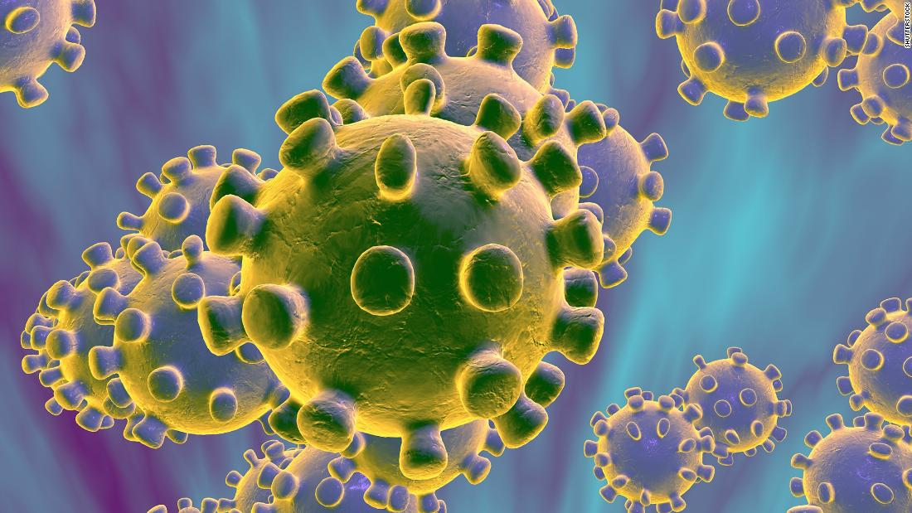
COVID-19 Infection Prevention and Control For Care Home Settings
May 2020 Version 1a

Slide 2
Principle 2
Personal Protective Equipment (PPE)

Slide 3
Why the changes in infection control precautions? And they may change again …….
New virus therefore at beginning of the outbreak little was known about route of transmission & mortality
COVID-19 has now been declassified as High Consequence Infectious Disease (HCID)
Evidence indicates that is spread by respiratory droplets not airborne
Precautions the same as for influenza:
Surgical masks protect mucous membrane from contamination by large respiratory droplet (and are as effective as FFP3 for this)
FFP3 recommended for Aerosol Generating Procedures (AGP) and supply needs to be protected for this purpose
Notes:
The 4 nations public health HCID group made an interim recommendation in January 2020 to classify COVID-19 as an HCID. This was based on consideration of the UK HCID criteria about the virus and the disease with information available during the early stages of the outbreak. Now that more is known about COVID-19, the public health bodies in the UK have reviewed the most up to date information about COVID-19 against the UK HCID criteria. They have determined that several features have now changed; in particular, more information is available about mortality rates (low overall), and there is now greater clinical awareness and a specific and sensitive laboratory test, the availability of which continues to increase.
The Advisory Committee on Dangerous Pathogens (ACDP) is also of the opinion that COVID-19 should no longer be classified as an HCID.
The need to have a national, coordinated response remains, but this is being met by the government’s COVID-19 response.
Cases of COVID-19 are no longer managed by HCID treatment centres only. All healthcare workers managing possible and confirmed cases should follow the updated national infection and prevention (IPC) guidance for COVID-19, which supersedes all previous IPC guidance for COVID-19.
Source: https://www.gov.uk/guidance/high-consequence-infectious-diseases-hcid
[19th March]

Slide 4
Notes:
A surgical mask doesn’t have a fluid resistant coating ……. They can be used for other things e.g. on a patient being transported where it’s preventing the droplets dispersing into the air, or placed over the mouth of the deceased as part of last offices
Eye/face protection – goggles or visor – disposable or reusable

Slide 5
PPE: Gloves
For procedures involving DIRECT contact with blood or body fluid
For direct patient/resident care
Risk assess procedure - if gloves are indicated put on immediately before commencing procedure
Remove and decontaminate hands immediately after the procedure
Gloves are not a substitute for good hand hygiene
Remember – viruses (and other pathogens) are transferred between patients, surfaces and your mucous membranes on your gloved hands
Do not wear the same pair of gloves for the care of more than one patient.
Do not wash/gel gloves.
Gloves cannot be reused.
Notes:
A pathogen is usually defined as a microorganism that causes, or can cause, disease inc a bacteria, virus, fungi or parasite

Slide 6
How many times an hour do you think you touch your face?
23 times on average
We are all pickers and pokers by nature ….
Some more than others
Notes:
Background: There is limited literature on the frequency of face-touching behavior as a potential vector for the self-inoculation and transmission of Staphylococcus aureus and other common respiratory
infections.
A behavioural observation study was undertaken involving medical students at the University of New South Wales. Their face-touching behaviour was observed via videotape recording. Using standardized scoring sheets, the frequency of hand-to-face contacts with mucosal or non-mucosal areas was tallied and analysed.
On average, each of the 26 observed students touched their face 23 times per hour. Of all face touches, 44% (1,024/2,346) involved contact with a mucous membrane, whereas 56% (1,322/2,346) of
contacts involved non mucosal areas.
Increasing medical students’awareness of their habituated face-touching behavior and improving their understanding of self-inoculation as a route of transmission may help to improve hand
hygiene compliance. Hand hygiene programs aiming to improve compliance with before and after patient contact should include a message that mouth and nose touching is a common practice. Hand hygiene is therefore an essential and inexpensive preventive method to break the colonization and transmission cycle associated with self-inoculation

Slide 7
PPE: aprons
Applying an apron
Perform hand hygiene.
Remove an apron from the roll or dispenser. Open it outwards ensuring the inner surface faces the patient to prevent any contamination on its outer surface coming into contact with the patient.
Place the neck loop over your head
Position the apron to cover as much of the front of your body as possible.
Fix the apron in place by tying the waist straps behind your back.
Removing an apron
If disposable gloves are being used, they should be removed first (Loveday et al, 2014).
Break the neck loop and waist straps.
Roll the apron downwards from your chest so the contaminated outer surface is folded inwards. Avoid touching the outer surface of the apron with your hands
Dispose of the apron in a hazardous waste bin.
Perform hand hygiene.

Slide 8
PPE – Fluid Resistant (Type 11R) Surgical Face Masks FRSM
FRSM provide barrier protection against respiratory droplets reaching the mucosa of the mouth and nose.
FRSMs are for single use or single session use and then must be discarded.
hand hygiene must be performed after disposal
FRSMs should:
Be well fitted: cover both nose and mouth
not be allowed to dangle around the neck after or between each use
not be touched once put on
be changed when they become moist, damaged, soiled
There is no evidence that respirators add value over FRSMs for droplet protection when both are used with recommended wider PPE measures in clinical care, except in the context of AGPs.

Slide 9
PPE: FFP3 respirator masks
FFP3 respirator masks are only used when AGPs are being carried out or when someone is working in an environment where many patients are undergoing AGPs
They filter out very small airborne particles
Protect from inhalation of fine airborne particles (droplet nuclei)
However, filtration is only effective only if sealed to contour of face
Fit testing required
Fit check before each use
Not required for other close contact and should be used prudently to conserve them for when they are needed

Slide 10
PPE: Eye & face protection Goggles or visor
Eye and face protection provides protection against contamination to the eyes from respiratory droplets, aerosols arising from AGPs and from splashing of secretions (including respiratory secretions), blood, body fluids or excretions.
Eye and face protection can be achieved by the use of any one of the following:
surgical mask with integrated visor
full face shield or visor
polycarbonate safety spectacles or equivalent
Regular corrective spectacles are not considered adequate eye protection.

Slide 11
Extending the use of PPE when in short supply
We all know that there is difficulty sourcing PPE particularly fluid repellent/resistant surgical face masks (FRSM 11R), visors and FFP2/3 respirators
To make the best use of what we have certain PPE can be used on a ‘sessional basis’ including masks, respirators and other face protection (goggles/visors)
BUT you must change your gloves and apron between patients / residents
You can extend the use of gowns by wearing an apron over the top and changing the apron as between residents / patients

Slide 13
Quick reference guide
You may have already printed off (and laminated) some quick reference guides to display as reminders to staff at the points where they are putting on and taking off PPE. The link is below:
https://assets.publishing.service.gov.uk/government/uploads/system/uploads/attachment_data/file/877658/Quick_guide_to_donning_doffing_standard_PPE_health_and_social_care_poster__.pdf

Slide 14
In summary

Slide 15
Removal of protective clothing (Doffing) is as important as wearing it
Discard mask when moist, damaged or visibly soiled
1
Remove PPE in this order:
2
Gloves (then decontaminate hands)
Apron/gown (avoid touching contaminated front surface)
Mask/eye protection
Decontaminate hands after all PPE has been removed
3
Notes:
There’s lots of talk of staff wearing PPE but how they take it off is as important as how they put it on to prevent the sprad of infection

Slide 16
Useful resources
Public Health Wales
https://phw.nhs.wales/topics/latest-information-on-novel coronavirus-covid-19/
Gov.UK
https://www.gov.uk/government/publications/wuhan-novel-coronavirus-infection-prevention-and-control
UK Infection Prevention Society
https://www.ips.uk.net
Healthcare Infection Society COVID resources
https://www.his.org.uk/resources-guidelines/novel-coronavirus-resources/

