Slide 1
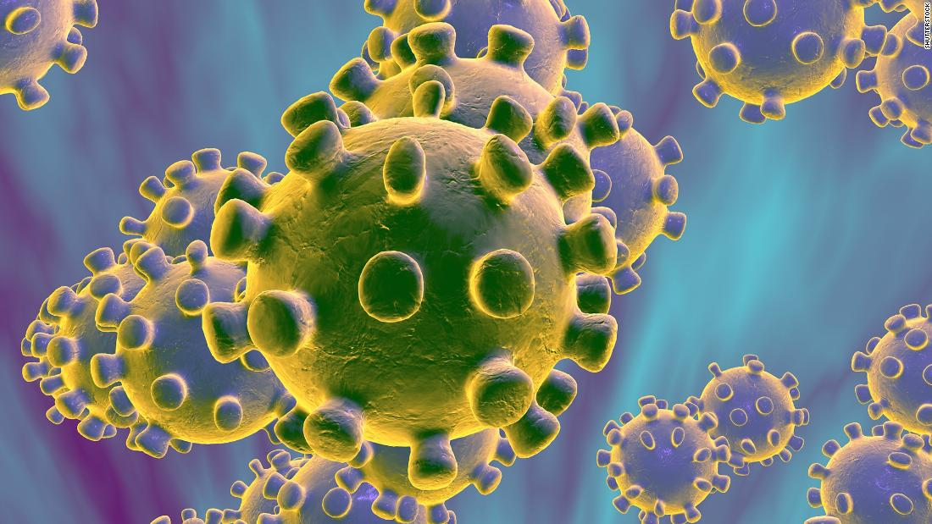
COVID-19 Infection Prevention and Control For Care Home Settings
May 2020 Version 1a

Slide 2
Principle 3
Isolation / Patient Placement

Slide 3
Transmission Based Precautions
Transmission-based precautions are used when standard precautions alone are not sufficient to prevent the spread of an infectious agent.
These include droplet precautions and airborne precautions
During a period of ‘sustained transmission’ of COVID-19, these precautions should be taken in any healthcare or care home setting not just with confirmed cases but those that are not currently a possible or confirmed case (within 2 metres)

Slide 4
Droplet precautions
Source control: put a mask on the patient/resident e.g. if they can tolerate it when they are moved outside of their room
Ensure appropriate ‘patient’ placement in a single room if possible. In long-term care and other residential settings, make decisions regarding ‘patient’ placement on a case-by-case basis considering infection risks to other residents in the room and available alternatives.
Use personal protective equipment (PPE) appropriately. Use of appropriate mask and eye/face protection (goggles / visor within 2 metres)
Limit transport and movement outside of the room to medically-necessary purposes.

Slide 5
Airborne precautions
Evidence to date: COVID-19 is not considered an airborne infection
However there are certain procedures that can generate aerosols from respiratory secretions known as ‘aerosol generating procedures (AGPs)
Additional precautions are necessary when AGPs are taking place including the use of respirator masks
AGPs include: Intubation & extubation, manual ventilation & open suctioning of the respiratory tract, sputum induction , non-invasive ventilation (BiPAP, CPAP), tracheostomy, bronchoscopy and other endoscopic procedures & dental procedures using a high speed drill.
Manual chest compression as part of CPR is also considered an AGP

Slide 6
Definitions of COVID-19 cases and contacts
Possible case of COVID-19 in the care home: Any resident (or staff) with symptoms of COVID-19 (high temperature or new continuous cough), or new onset of influenza like illness or worsening shortness of breath.
Confirmed case of COVID-19: Any resident (or staff) with laboratory confirmed diagnosis of COVID-19.
Infectious case: Anyone with the above symptoms is an infectious case for a period of 7 days from the onset of symptoms.
Resident contacts: Resident contacts are defined as residents that:
Live in the same unit / floor as the infectious case (e.g. share the same communal areas).
or
Have spent more than 15 minutes within 2 metres of an infectious case.
Staff contacts: Staff contacts are care home staff that have provided care within 2 metres to a possible or confirmed case of COVID-19 for more than 15 minutes.
Outbreak: Two or more cases which meet the case definition of possible or confirmed case as above, within a 14-day period among either residents or staff in the care home.

Slide 7
Isolation of COVID-19 symptomatic patients/residents: Single case
All symptomatic residents should be immediately isolated for 14 days from onset of symptoms.
Symptomatic residents should ideally be isolated in single occupancy rooms with en-suite facilities or a dedicated bathroom/toilet facility
If you have to transfer a symptomatic resident between rooms, the resident should ideally wear a surgical face mask.
Clearly sign the rooms - indicating droplet precautions in addition to standard precautions (airborne precautions if AGPs being carried out) at the entrance of the room.
If possible, staff should only work with either symptomatic or asymptomatic residents. Staff who have had confirmed COVID-19 and recovered should care for COVID-19 patients/residents. Such staff must continue to follow the infection control precautions, including PPE as outlined in this document.

Slide 8
Isolating a single case
Room door(s) should be kept closed where possible and safe to do so. Where this is not possible ensure the bed is moved to the furthest safe point in the room to try and achieve a 2 metres distance to the open door as part of a risk assessment.
All necessary procedures and care should be carried out within the resident’s room. Only essential staff (wearing PPE) should enter the resident’s room and the resident should stay in the room even for meals
Entry and exit from the room should be minimised
Dedicate specific medical equipment (e.g. thermometers, blood pressure cuff, pulse oximeter, etc.) for the use of care home staff for residents with possible or confirmed COVID-19. Clean and disinfect equipment before re-use with another resident.
Restrict sharing of personal devices / items (mobility devices, books, electronic gadgets) with other residents.

Slide 9
Cohorting: Placing patients with COVID-19 in multi-occupancy rooms
Cohorting of contacts within one unit rather than individually: Consider this option if isolation in single rooms is not possible due to shortage of single rooms when large numbers of exposed contacts are involved.
Protective cohorting of unexposed residents: Residents who have not had any exposure to the symptomatic case can be cohorted separately in another unit within the home away from the cases and exposed contacts.
Extremely clinically vulnerable residents should be in a single room and not share bathrooms with other residents.
Where possible assign staff to work in COVID-19 designated areas and not care for other residents
Change PPE and clean hands between patients in the cohort area - NB use masks / visors (or goggles) can be worn on a sessional basis
Avoid using agency staff especially in areas with known COVID-19 positive patients
Restrict visiting in line with government guidelines
Notes:
Where this is not practical, cohort symptomatic residents together in multi-occupancy rooms. Residents with suspected COVID-19 should be cohorted only with other residents with suspected COVID-19. Residents with suspected COVID-19 should not be cohorted with residents with confirmed COVID-19.
Do not cohort suspected or confirmed patients next to immunocompromised residents.

Slide 10
Staff with COVID-19
If you develop symptoms then DO NOT come into work:
Acute onset fever (temperature over 37.5ºC, new persistent cough, breathlessness
Inform your manager
Self-isolate at home for 7 days from onset of symptoms
If your symptoms worsen contact NHS 111
Do not return to work after 7 days if you still have a temperature (normal temperature for 48 hrs)
Staff at high risk of complications from COVID-19
risk-assessment to manage their deployment
Notes:
Link to Gov.uk - self isolation

Slide 11
Useful resources
Public Health Wales
https://phw.nhs.wales/topics/latest-information-on-novel coronavirus-covid-19/
Gov.UK
https://www.gov.uk/government/publications/wuhan-novel-coronavirus-infection-prevention-and-control
UK Infection Prevention Society
https://www.ips.uk.net
Healthcare Infection Society COVID resources
https://www.his.org.uk/resources-guidelines/novel-coronavirus-resources/

