Slide 1
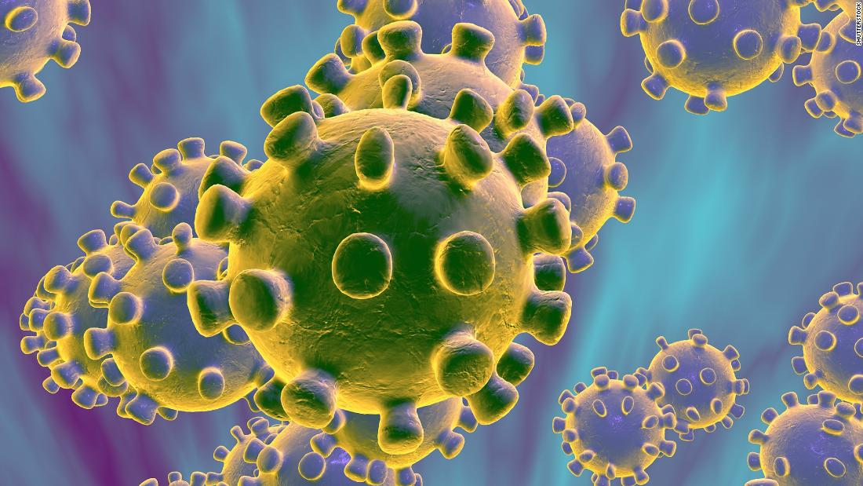
COVID-19 Infection Prevention and Control For Care Home Settings
May 2020 Version 1a

Slide 2
Principle 4
Environmental cleaning and disinfection

Slide 3
Cleaning and Disinfection
Surfaces will become contaminated with respiratory secretions
Directly from coughing/sneezing
Indirectly by touching with contaminated hands
Contamination greatest where AGP performed
COVID-19 will survive in on surfaces for at least 3 days
Copper – 4 hours, cardboard 24 hours, plastic / steel 72 hours
Easily removed by cleaning & disinfection
Detergent & water followed by disinfectant OR a combined cleaning and disinfecting product
Chlorine at 1000ppm may damage equipment and cause breathing difficulties in staff and residents
Use of a viricidal disinfectant complies with EN14476
Notes:
There are many other safer and more cost-effective disinfectants which will neither damage equipment nor the environment.
These newer disinfectants will they reduce occupational risk, e.g. asthma. Further in environments where patients are having difficulty in breathing, advocating an agent which affects breathing seems illogical and potentially harmful.
Reliance on hypochlorite is:
Non-cost effective – too many steps to the procedure; Damages equipment; Causes breathing difficulties to patients and staff.
Other safer products are available provided they can kill viruses.
EN14476 – COVID-19 an easily killed virus in the environment (with the right disinfectants).

Slide 4
Environmental Cleaning
Wear PPE
Train staff inc clinical staff in the principles of cleaning & disinfection, and what products should be used when / where
Keep everywhere as clutter free as possible
Isolation rooms clean at least daily (high-touch areas more frequently)
Discharge clean: Close door, open window if possible – leave for 1 hour IF AGPs have been carried out in room
Use disposable mops and cloths
Body fluid spills - as per local policy

Slide 6
Principles of Cleaning

Slide 7
New technologies / rapid teams
Total room decontamination: UVC and hydrogen peroxide vapour – specialist technology; needs proper training and follows on from manual cleaning not instead of manual cleaning
Consider additional cleaning capacity / ‘rapid response teams’ to supplement standard cleaning

Slide 8
Waste disposal
Waste: discard waste from patient/resident rooms including tissues and PPE as clinical waste
Current guidance: double bag; leave for 72 hours then dispose of as usual.
Check with Local Authority for any local/ additional requirements

Slide 9
Laundry
Place used linen directly into alginate bags (red or clear with red stripe) then outer linen bag if washed off site. Do not overfill bags.
Reduce handling to a minimum. Use a linen skip as close as possible to the room but not in the room.
Do not:
Sort, shake or rinse linen on removal from beds.
Place used/infectious linen on the floor or any other surface e.g. table top.
Re-handle used/infectious linen when bagged or overfill laundry bags
Laundry must be tagged with the care area and date, and stored in a designated, safe lockable area whilst awaiting uplift or laundering.
It should be laundered in line with local policy for infectious linen.
Patient / resident clothing should be bagged and washed at or over 60ºC or at the hottest temperature possible for the fabric. Then tumble dry and/or iron.
For further guidance : HTM 01-04 https://assets.publishing.service.gov.uk/government/uploads/system/uploads/attachment_data/file/527545/Social_care.pdf

Slide 10
Enquiries
Email: Sue Rees - Advanced Nurse Practitioner, Infection Prevention (Community)
Sue.Y.Rees@wales.nhs.uk
Phone HDUHB COVID Enquiry Line
0300 303 8322

Slide 11
Useful resources
Public Health Wales
https://phw.nhs.wales/topics/latest-information-on-novel coronavirus-covid-19/
Gov.UK
https://www.gov.uk/government/publications/wuhan-novel-coronavirus-infection-prevention-and-control
UK Infection Prevention Society
https://www.ips.uk.net
Healthcare Infection Society COVID resources
https://www.his.org.uk/resources-guidelines/novel-coronavirus-resources/

